Slide 1

Do Hitters’ Parks Actually Exist in MLB
In order to determine if hitters’ parks exist we need to look at the park factor as it is currently calculated. We will compare a statistical model to the park factor to validate whether or not hitters’ parks do in fact exist.
The current park factor is calculated as such:
PF =
(Runs scored by the home team + Runs given up by the home team ) ÷ Home Games Played
(Runs scored by the away team + Runs given up by the away team ) ÷ Away Games Played
To give an example if we wanted to determine the park factor for Fenway Park in 2015, we would calculate it as follows. That year the Boston Red Sox pitching allowed 374 runs in Fenway Park, and conversely they scored 324 runs in Fenway Park over 81 games. On the road they scored 310 runs around MLB parks not including Fenway, and their pitching allowed 341 runs in those same parks over 81 games. Therefore, our numbers compute as follows:
(374 + 324 ) ÷ 81
Fenway Park PF =
(310 + 341 ) ÷ 81
After completing the mathematical operations, we are left with the average amount of runs per game as 8.62 scored in Fenway Park in 2015.
During the games that the Boston Red Sox played that were not in Fenway Park that year, the average amount of runs per game is 8.04.
Divide the average runs per game for Fenway Park, by the average runs per game not in Fenway Park where Boston was a participant,
and we are left with 1.07. Under the current model, any park factor greater than 1.0 is considered a hitters’ park, and any number less
than 1.0 is considered a ptichers’ park. The closer to 1.0 the number is the more neutral the park is considered.
Based on this model, Fenway Park in 2015 is considered a hitters’ park.

Slide 2


STATISTICAL ANALYSIS
We evaluate our first statistical model based mostly on stats. The current park factor formula includes runs, so we will leave that stat out. We still have run producing stats including RBIs (Runs Batted In) and ERA (Earned Run Average). We would like to leave runs out of our statistical model, because should we leave them in we prove absolutely nothing by this study other than validating the calculation methods of the park factor.
Our whole data set will include ERA; total batters faced; hits allowed; homeruns allowed; batting average against; slugging against; plate appearances; hits; homeruns; RBIs; batting average; slugging; distances to each left field, left center, center field, right center, and right field; distance from home plate to the backstop; the amount of fair and foul territory; and the height of each wall in left, center, and right field.

Slide 3

Slide Details
In the following slides the following details should be noted.
A statistical model was trained on 9 years of baseball stats, park dimension, and weather statistics.
I was forced to restrict the data to 9 years here as I was not able to obtain split statistical data for home vs away stats which is crucial to this study.
The final test data was conducted on 5 years worth of the same data.
The height of the following charts show the percentage of the time over the 5-year period that a particular MLB park weighed in as a hitters’ park.
Formula as charted is the park factor as it is currently calculated, and it is colored blue.
Prediction is the statistical model’s prediction over the 5-year period as to whether or not a particular park weighed in as a hitters’ park, and it is colored green.

Slide 4
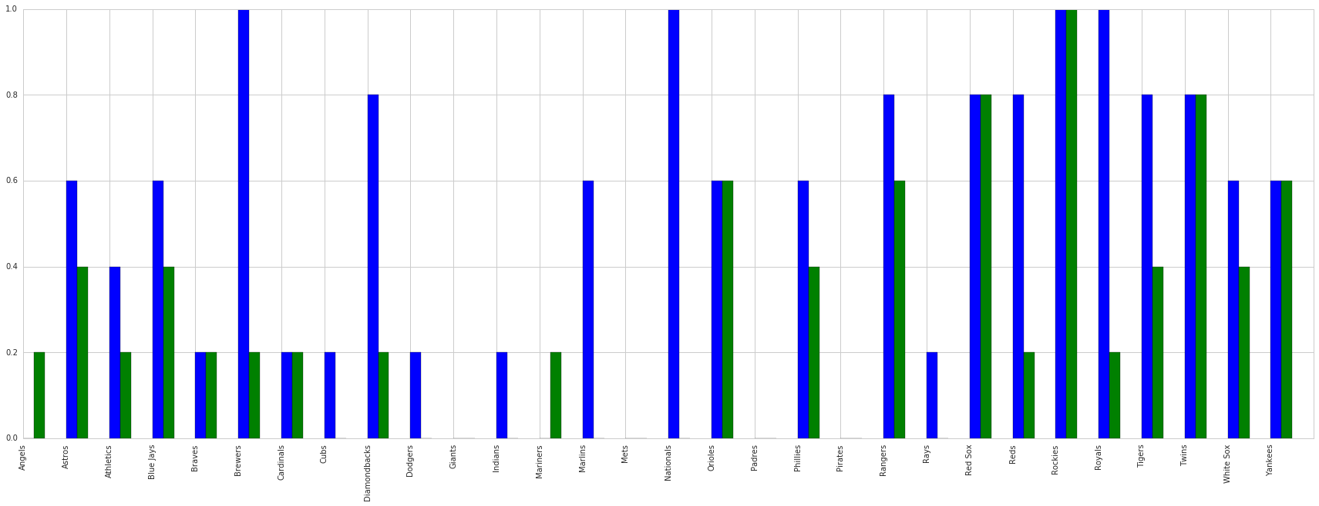
STATISTICAL ANALYSIS
On mere statistical analysis, we get 69% accuracy on our model versus the calculated park factor.
Formula
Prediction

Slide 5

Other factors
We had previously based our model almost solely on statistical data, but can a model be generated to account more for external factors outside of the stats to truly determine if a MLB park is a hitters’ park or a pitchers’ park.
The best example of external factors is Coors Field in Denver, Colorado. Here the stadium sits at 5200 feet above sea level which is nearly 5000 feet higher than any other stadium. As a result the baseball in Coors Field travel farther due to the air being less dense. As a result a number of hitters have seen their power numbers take a significant boost once joining the Colorado Rockies baseball team where they have not generally been considered true power hitters before joining the Colorado baseball team.
Baseballs typically travel farther in the summer than they do in the colder months of spring and fall. This is again due to the heat and the overall temperature in the air. As the weather gets warmer, the air around the baseball gets less dense allowing for greater travel.
Therefore, this should also hold true for southern teams such as the Texas Rangers and Arizona Diamondbacks where the heat is much drier and thus less humidity in the air allowing for greater flight of the baseball. In the next statistical model, we have included the average amounts from April 1st thru October 1st for each year.
Our weather data includes maximum, average, and minimum temperatures; maximum, average, and minimum humidities, high and averages winds; and elevation.

Slide 6
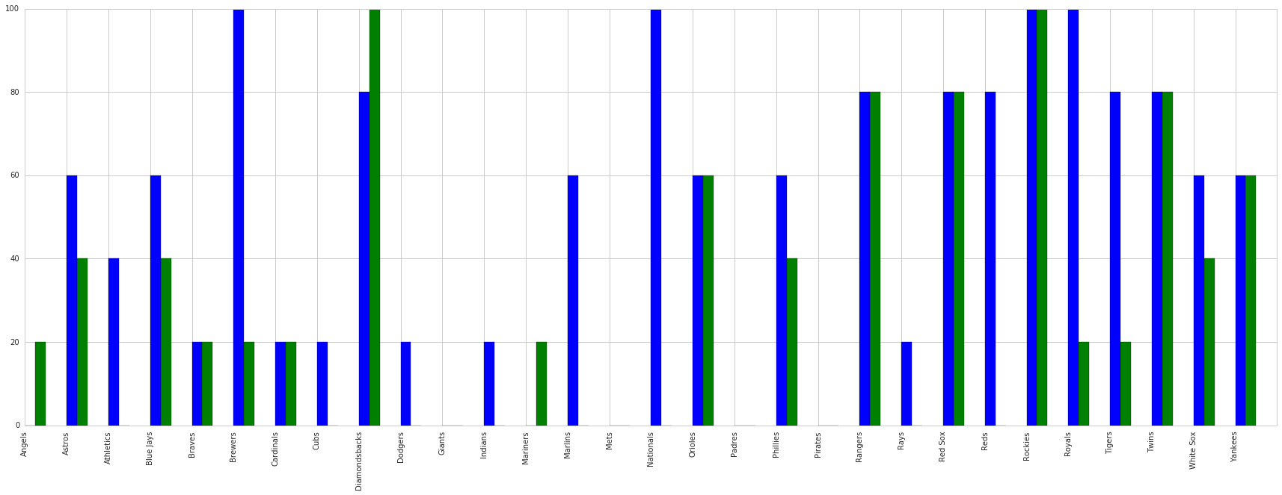
Weather added to statistical model
When weather was added to the data set we had 68% accuracy.
Formula
Prediction

Slide 7

Weather data with only hitter stats
In our next statistical model, we would like to see if our statistical model should hold up when it contains only the very basic hitting statistics and the very basic power numbers.
Here we get to see if the park dimensions, temperature, humidity, wind, and elevation have an effect on a player’s ability to generate hits and power numbers.
We will leave only batting average and hits for both the home and away teams to see how often a player gets a hit in a particular park.
We will leave slugging and homeruns included to see if a particular park favors in the power numbers. Slugging percentage can be calculated as follows.
Slugging = Total Bases ÷ At Bats
Slugging is important to the power numbers as it helps to include the number of doubles, triples, and homeruns in the statistics. By no way does this statistic directly influence the number of runs as we said we wanted to leave this statistic out otherwise we prove absolutely nothing by conducting this study.
It is important that we include a statistic that factors in doubles and triples as there are certain parks where the surface can play faster than others. This enables the ball to penetrate the gaps easier factoring in an increase to the number of extra base hits.

Slide 8
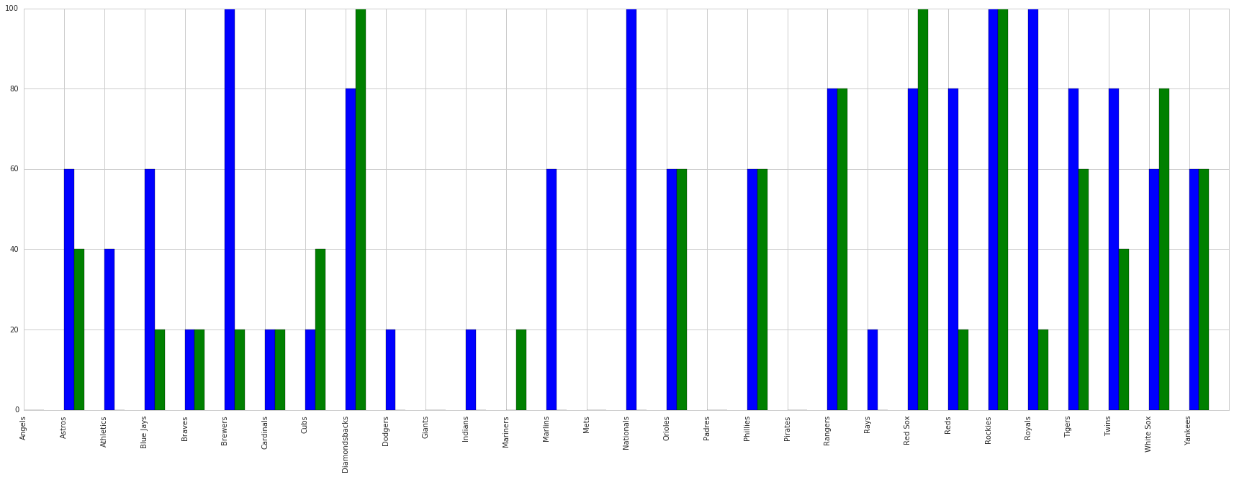
Final Model
In our final model with weather and minimal baseball stats, we obtained an accuracy of 71%
Formula
Prediction

Slide 9
PRECISION, RECALL & auc sCORE
Precision and Recall
Our model correctly identified a hitters’ park 81% of the time. Our model however did not do very well in recall as 53% of the time that it identified a park as a hitters’ was it actually a hitters’ park.
Obviously with having such a low number for recall where hitters’ parks are concerned our precision for pitchers’ park did poorly as it only correctly identified 67% of the pitchers’ parks. It’s recall for pitchers’ parks was pretty good, and 88% of the time it identified a park as a pitchers’ was it actually a pitchers’ park.
This would suggest to me that our model over evaluates the numbers for hitters’ parks, and too often identifies a pitchers’ park as a hitters’ park.
AUC Score
Our model has an AUC Score of 0.796. Therefore, our model is fairly good. The AUC score here measures the effectiveness of our model in having true positives versus having false positives. If our true positive rate is much greater than our false positive rate then our model is performing well.

Slide 10
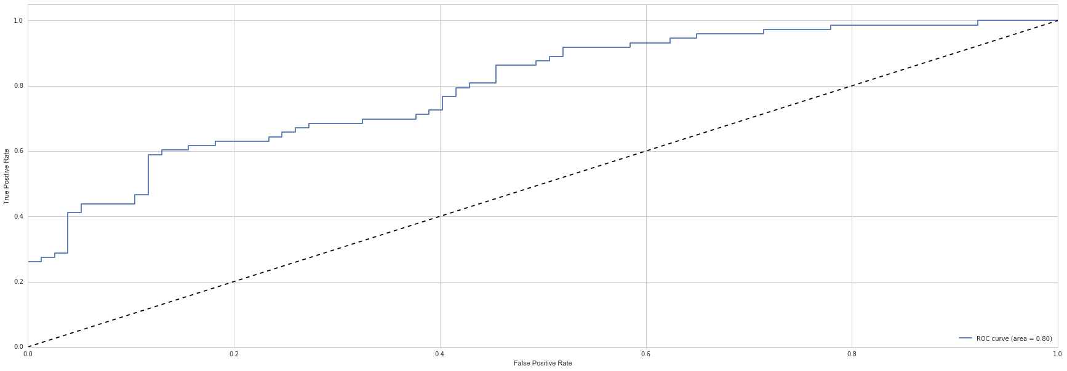
ROC Curve
As we see the slight bend upward it shows the effectiveness of our model. The farther we get away on the upper side from the x=y dashed line the more effective our model is.

Slide 11

Cross Validation Score
The last measure of our model is the cross validation score. In any statistical model there will be variation from one run of the model to the next. By using cross validation we can gauge the variance between numerous runs on our model.
The mean accuracy score of our model is 63% with a 8.6% confidence interval.
This means that with this test being repeated over and over there is a 95% chance that the accuracy will fall within 8.6 on either side of 63%.
Obviously, 55% will not be a very good accuracy rate, but then there are runs of our model that will also have 71% accuracy rate.

Slide 12

CONCLUSION
With this model, I believe we can reasonably say that there is a definite distinction between hitters’ parks versus pitchers’ parks.
Parks like the Oakland Coliseum with its expansive foul territory, and parks where temperatures don’t get too warm with a reasonably amount of humidity will ultimately remain pitchers’ park.
Parks like Fenway Park in Boston with very little foul territory, and parks where temperatures can climb, winds generally blow out to the bleachers, and it is a drier heat will remain hitters’ park.
Parks that the wind is unpredictable like Wrigely Field, and parks where the dimensions don’t really favor either the hitter or the pitcher will shift back and forth between being a pitchers’ park and being a hitters’ park.

Slide 13

CREDITS
Baseball statistics were collected from fangraphs at www.fangraphs.com using home and away splits for each team.
Baseball stadium info for the distance from home plate to each fence, the heights of each wall, distance from home plate to the backstop, and the amount of fair and foul territory were collected from Clem’s Baseball Blog at www.andrewclem.com/Baseball/Stadium_lists.html
Historical weather data was collected from www.wunderground.com
Elevation data was collected using a Google search with the city name followed by the word “elevation.”

